Slide 1


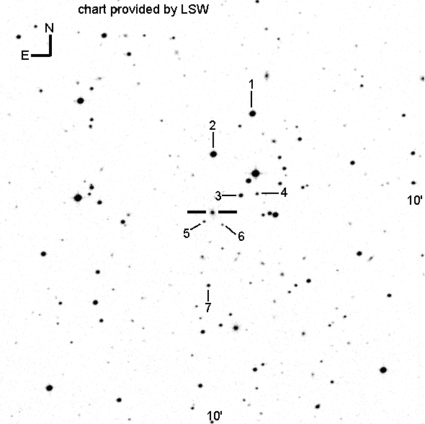
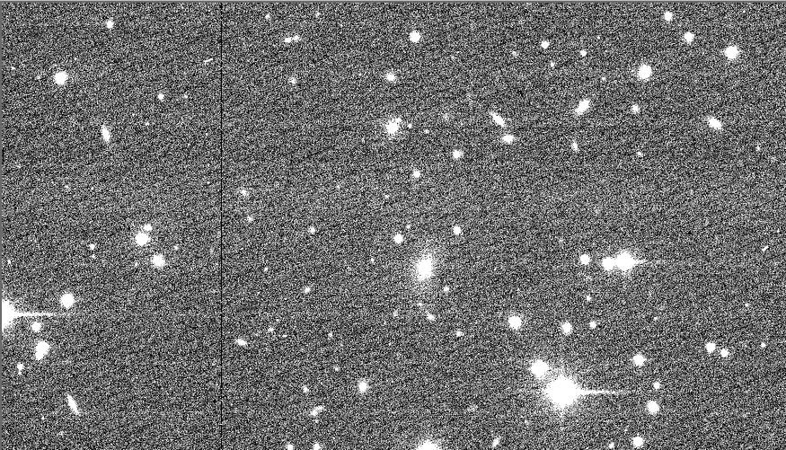


The Search for Optical Microvariability by an X-Ray Selected Blazar: 1ES 1101-232
Alexa Sheets
Georgia Gwinnet College - School of Science and Technology
Research Mentors: Dr. Amy Battles, Dr. Tae Lee, Dr. Sairam Tangirala
Photometry
Introduction
Undergoing Research
CCDs were initially created as a memory storage device, but their specific method of turning photons into a charge has given astronomers an advantage since the CCD has 100x greater photosensitivity than that of film. The raw images produced from a CCD are the most valuable, purest form of data. They must be cleaned and calibrated in order to quantify the data obtained from them and serve as a reference point for all data henceforth. [3]
We are reducing images from the SMARTS Consortium in order to produce light curves and use statistical analysis to determine if microvariability occurred via the analyzation of 8 nights of new optical data that was observed on a 0.9-meter telescope in Chile this year via the SMARTS Consortium. We have currently run an image analysis of the magnitude of our object in comparison with that of objects 1, 2, 3, and 4. Currently, that data is undergoing our process of differential photometry in order to determine the measure of brightness between those four objects and 1ES 1101-232.
1ES 1101-232 is the most distant BL Lacertae object (BL Lac) known, which is a rare type of active galactic nuclei (AGN). With a redshift (z) of 0.186, it’s a blazar with the highest confirmed redshift detected in VHE $γ$-rays so far. Most VHE blazars detected thus far belong to the classes of x-ray selected BL Lacs or high frequency BL Lacs. The elliptical galaxy of which 1ES 1101-232 resides is one of the brightest BL Lac host galaxies detected thus far. The BL Lac itself has a typical brightness of $m_{V}$ = 16 to 17, where the optical emission from 1ES 1101-232 has typically varied on the timescale of months. [2]
Specifications
RA: 11hr 03min 37.615arcsec
Dec: -23° 29min 31.20s
Coordinate Epoch: J2000
B: 17.00
V: 16.55
R: 16.61
Z(Redshift): 0.186
Results
Analysis
1ES 1101-232 is the object centered in the finder chart, not numbered. Objects 1-7 are used as comparison objects for the process of differential photometry. Differential photometry is the measurement of the difference in brightness of two objects and is the simplest of the calibrations and the most useful for time series observations. Given an image processed by a CCD, both the target object and comparison objects are observed at the same time, with the same filters, using the same instrument, and viewed through the same optical path which leaves little room for systematic or random error. The differential magnitude can then be calculated as the difference between the observed magnitude of the object minus the observed magnitude of the comparison object. This value is used to plot the change in magnitude over time of the target object, which can be compiled into a light curve. [2]
References
1. UBVRI PHOTOMETRY OF STARS IN THE FIELDS OF X-RAY SELECTED BL LACERTAE OBJECTS. Paul S. Smith, Buell T. Jannuzi, and Richard Elston. s.l. : The American Astronomical Society, September 1991, The AstrophysicalJournal Supplement Series.
2. Detection of VHE gamma-ray emission from the distant blazar. F. Aharonian, A. G. Akhperjanian, A. R. Bazer-Bachi, M. Beilicke, W. Benbow, D. Berge, K. Bernlöhr... s.l. : Astronomy and Astrophysics, 2007.
3. Janesick, James R. Scientific Charge-coupled Devices. s.l. : SPIE Publishing, 2001
[1]

